Slide 1



Dashboard App Using R (and only R) with Shiny Framework
Raden Muhammad Hadi

Slide 2






Profile
Raden Muhammad Hadi
Web Developer @Tabel Data Informatika
Statistical Consultant @StatsMaster
Math Graduate, Specialize in Algebra
(read: Abstract Nonsense)
hadimaster65555.github.io
bit.ly/radenmhadi

Slide 3
Outline
Static Web vs Dynamic Web
Web Application
Data Visualization and Why It Matters
Dashboard and Why it Useful
Introduction to R & Shiny Framework
Shiny Application
Demo App
Live Coding

Slide 4
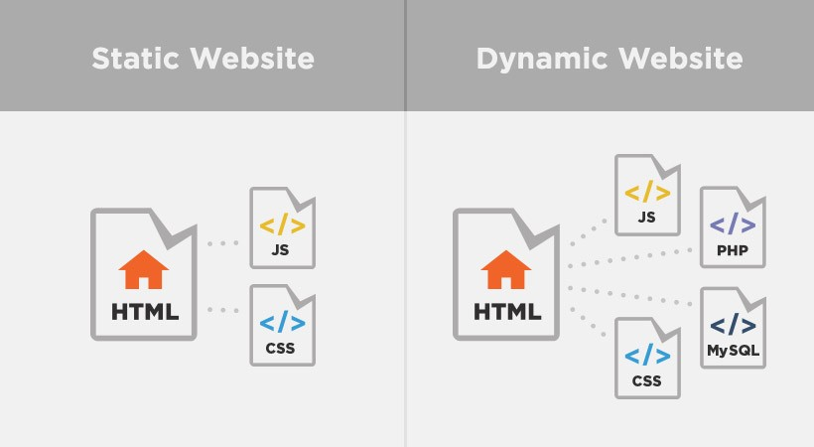
Static Web vs Dynamic Web

Slide 5
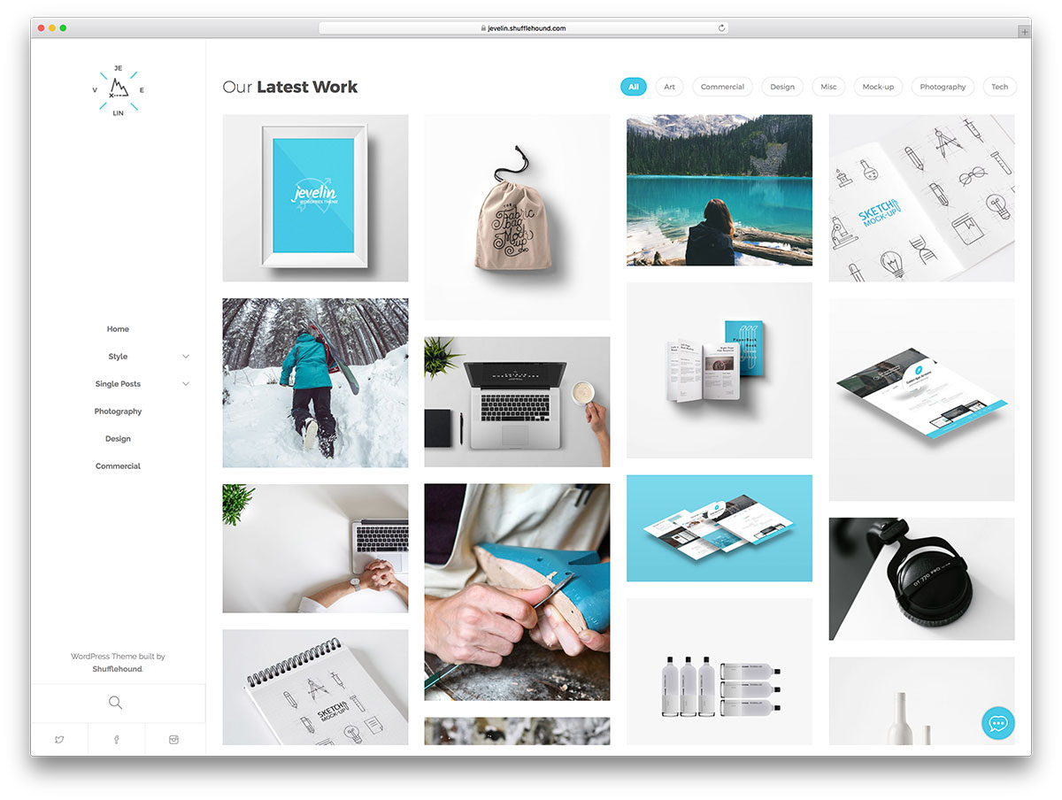
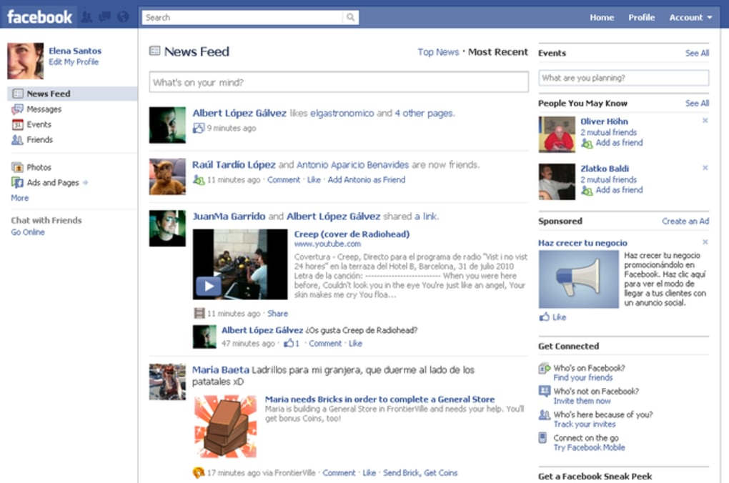
Static
Dynamic

Slide 6




Web Application
It’s a client/server application uses a Web Browser as its client program.
Performs an interactive service.
Presents dynamical tailored content based on request parameters, user behaviors and security consideration.
- Web Application Architecture: Principles, Protocols and Practices by Leon Shklar, Richard Rosen

Slide 7
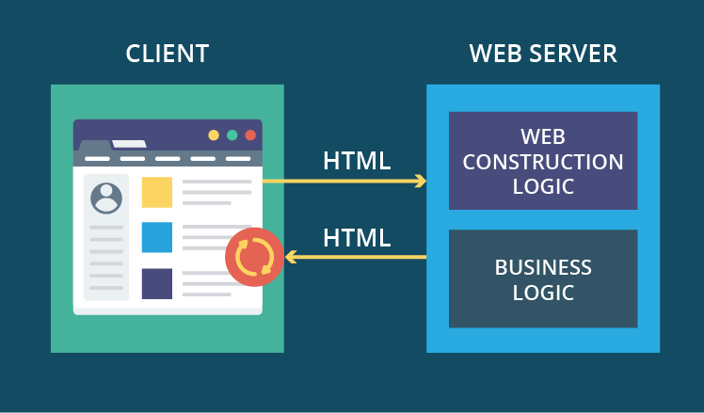

Slide 8
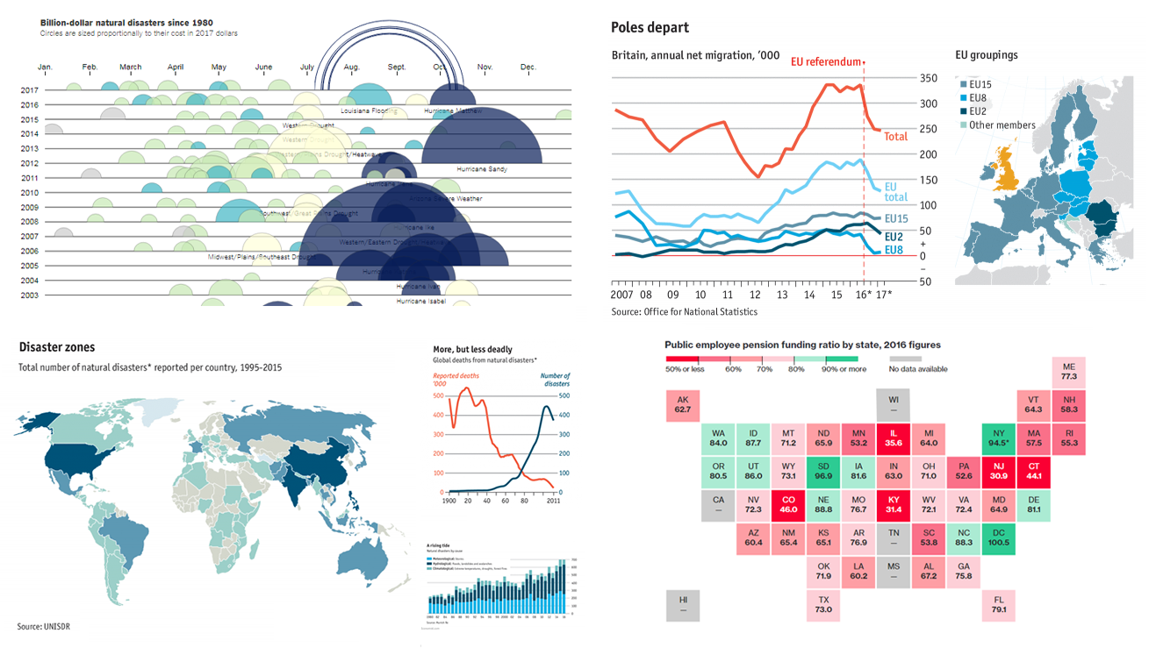
Data Visualization and Why It Matters

Slide 9
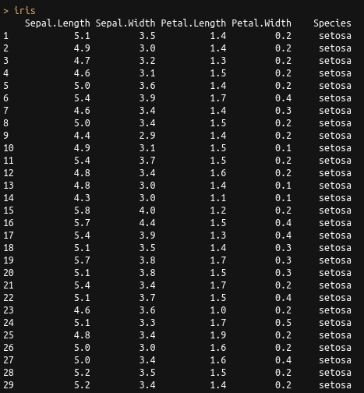


Slide 10
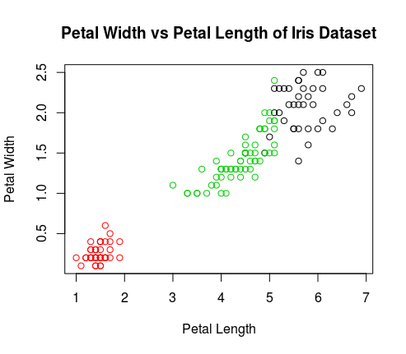


Slide 11
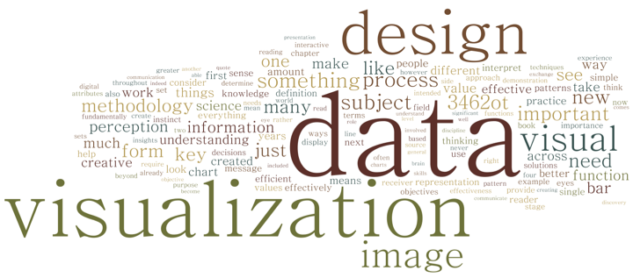

Slide 12
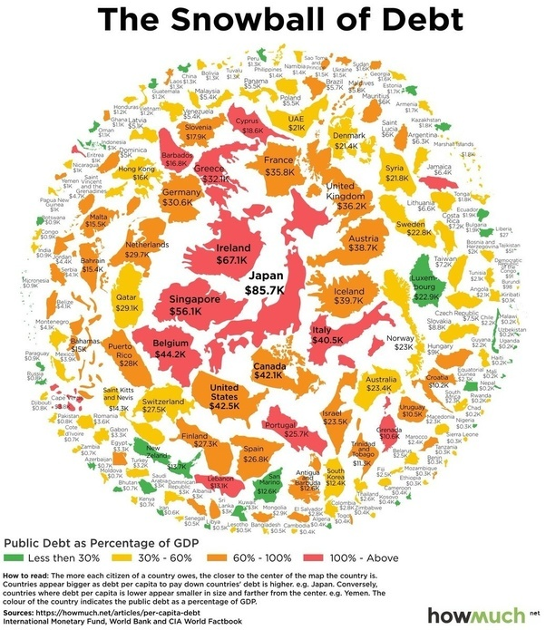
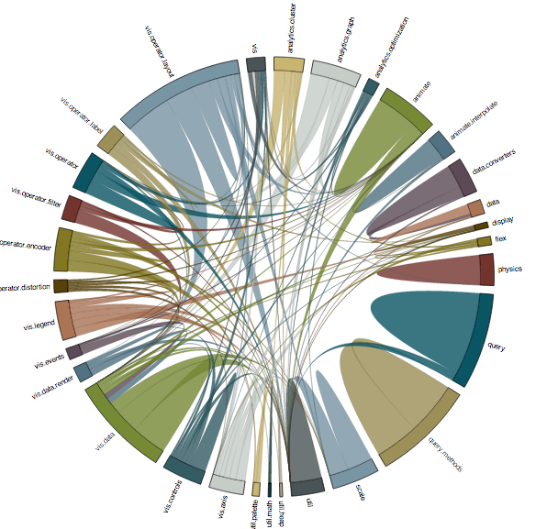

Slide 13

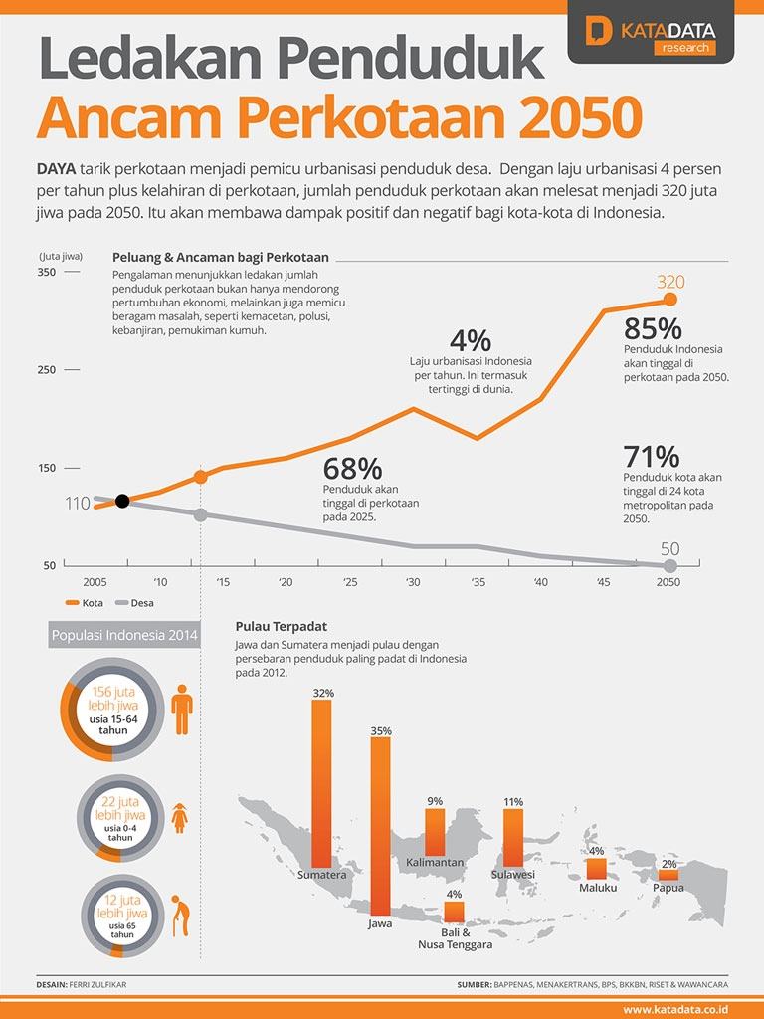

Slide 14
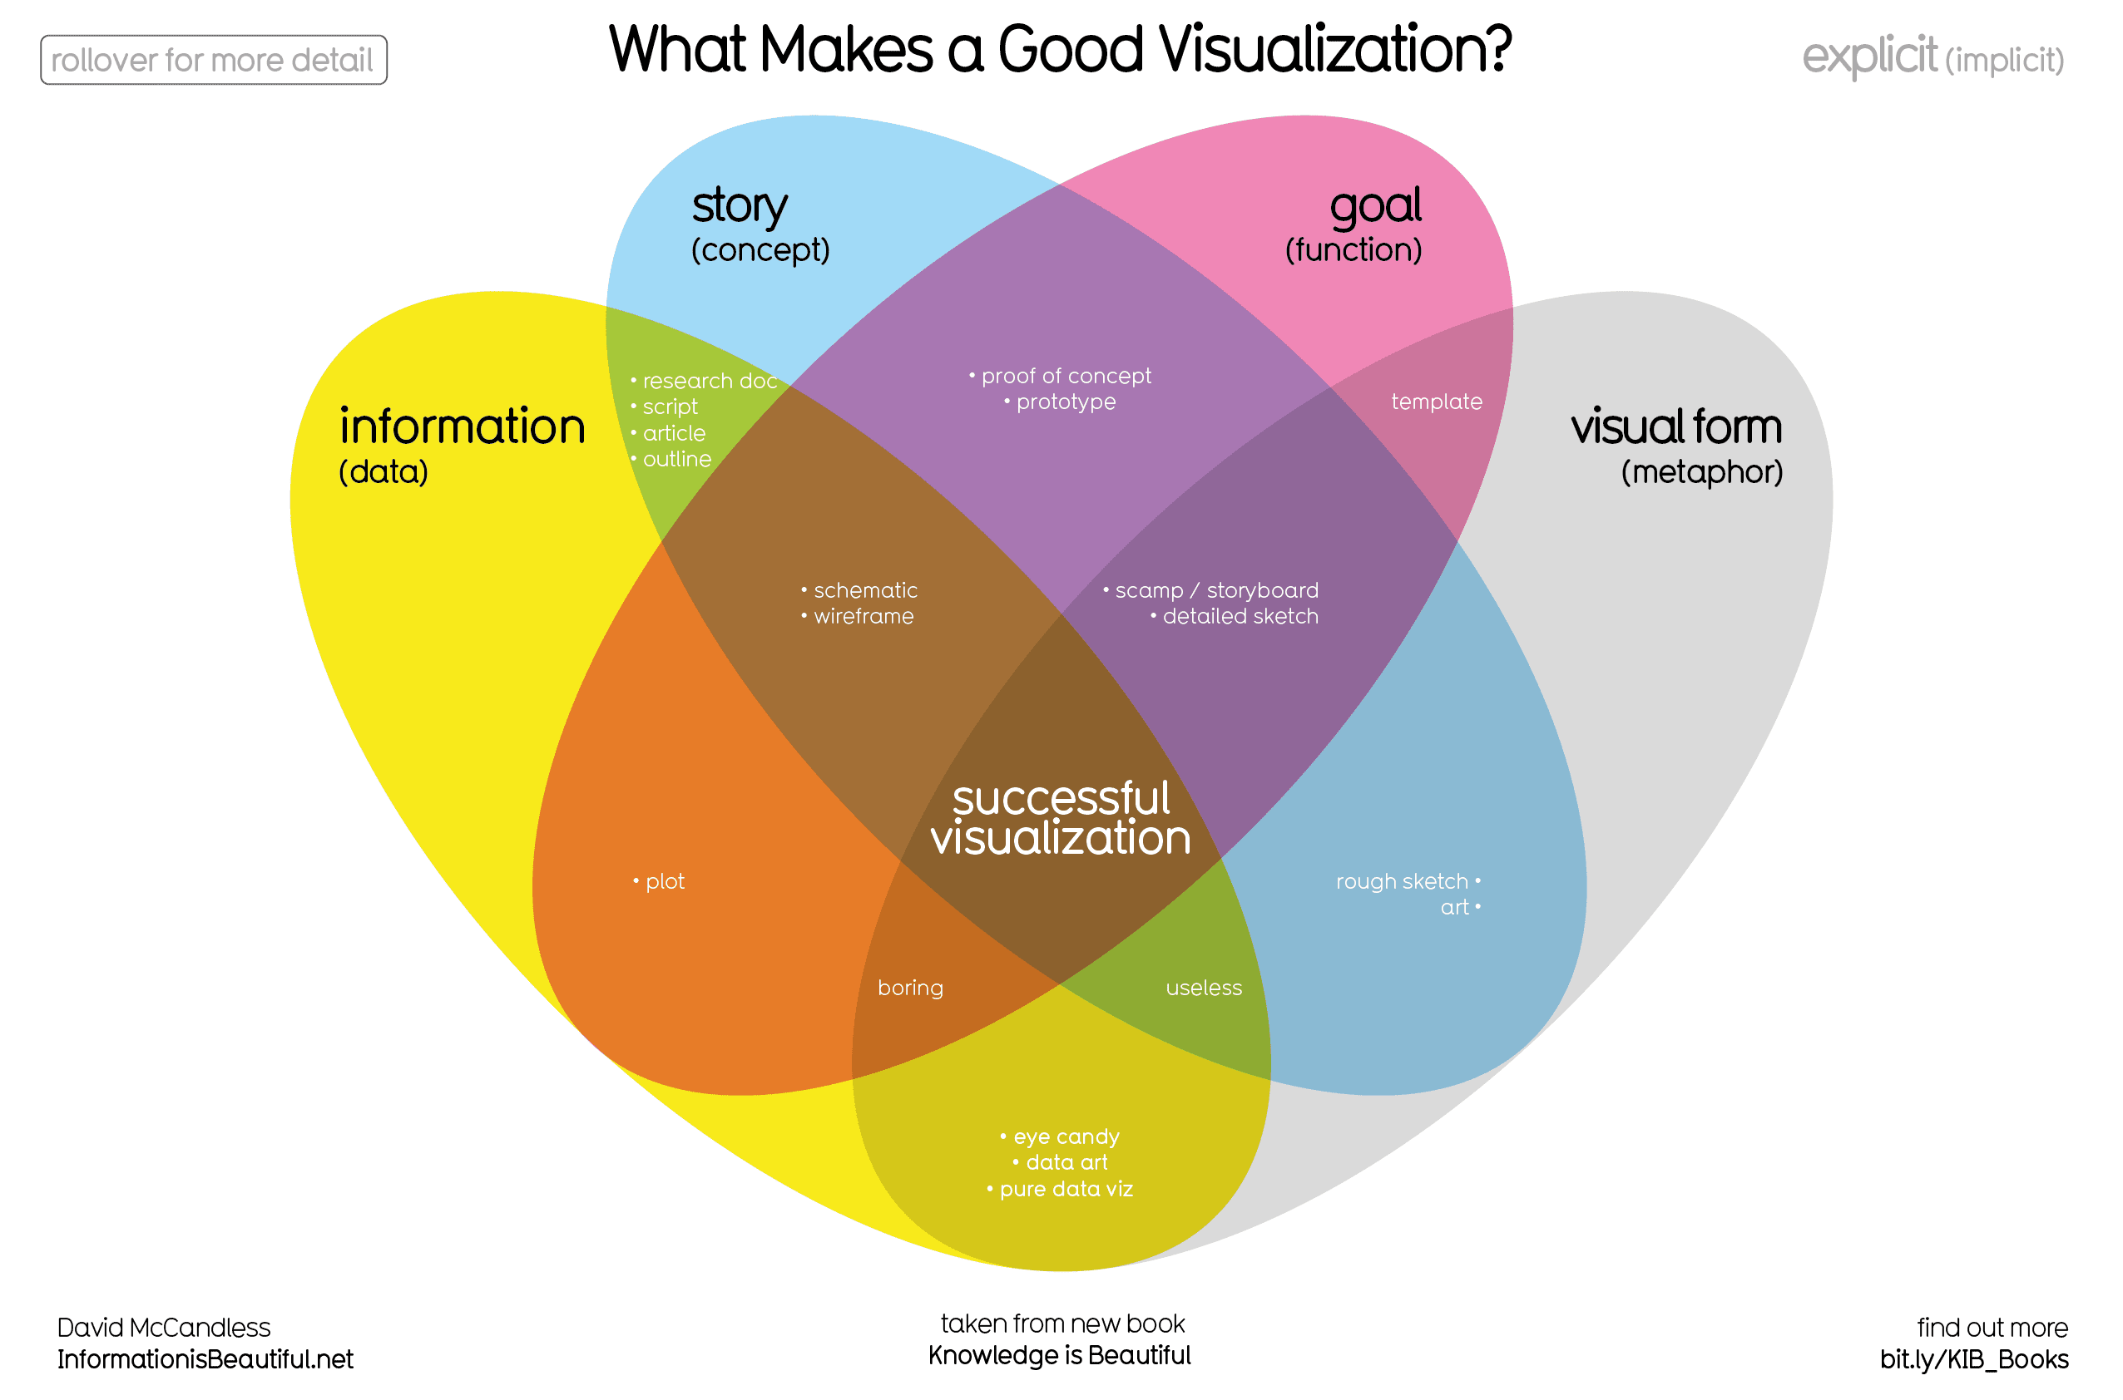

Slide 15
Can we applied the same ‘art’ to business problem?

Slide 16
NO

Slide 17
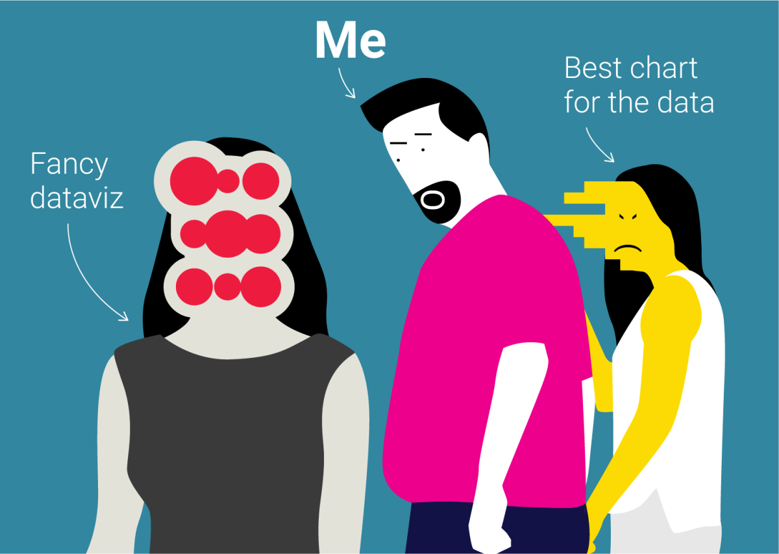

Slide 18
Dashboard and Why it Useful

Slide 19
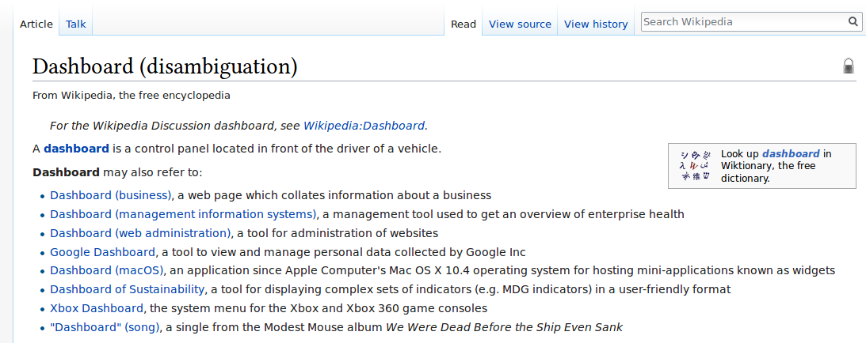
What is Dashboard

Slide 20
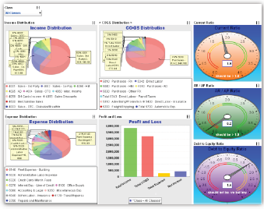
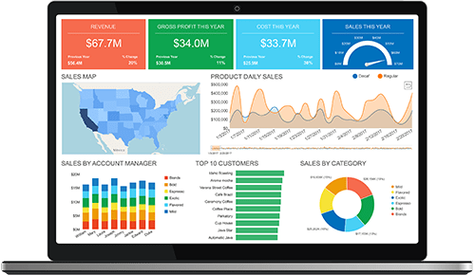
What is Dashboard
are an easy-to-digest view of some indicators that lets viewers spot decisions and act on opportunities quickly.

Slide 21
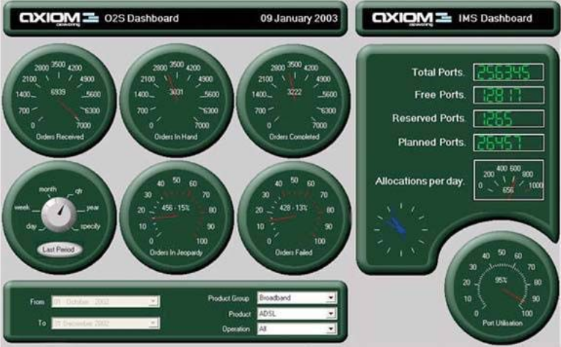

Slide 22


Slide 23
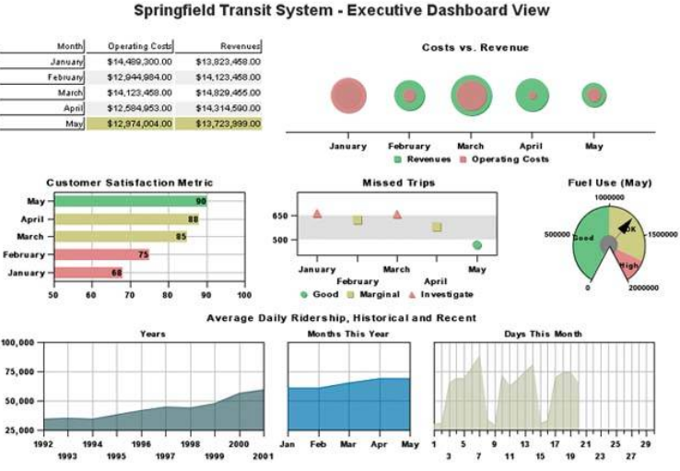

Slide 24


Slide 25
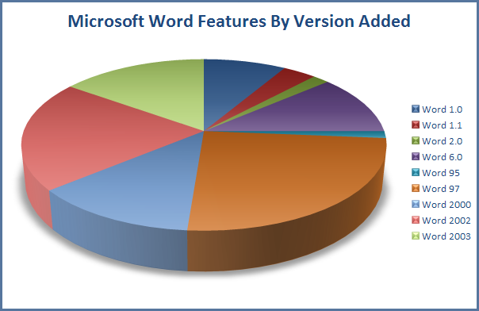

Slide 26
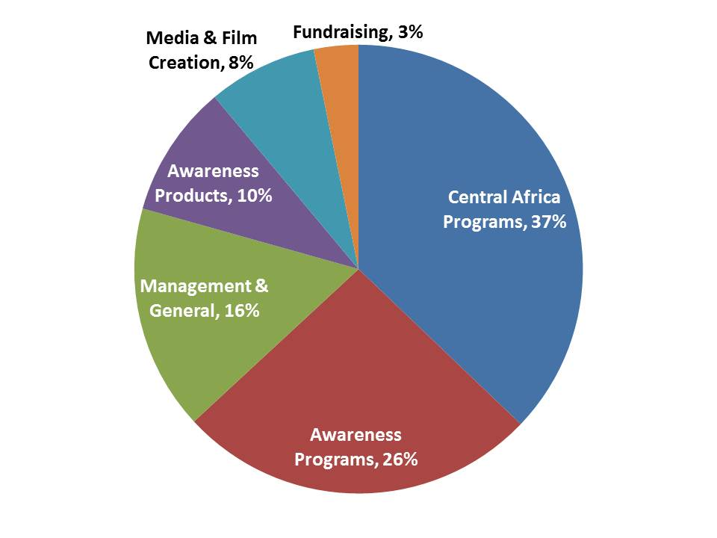

Slide 27
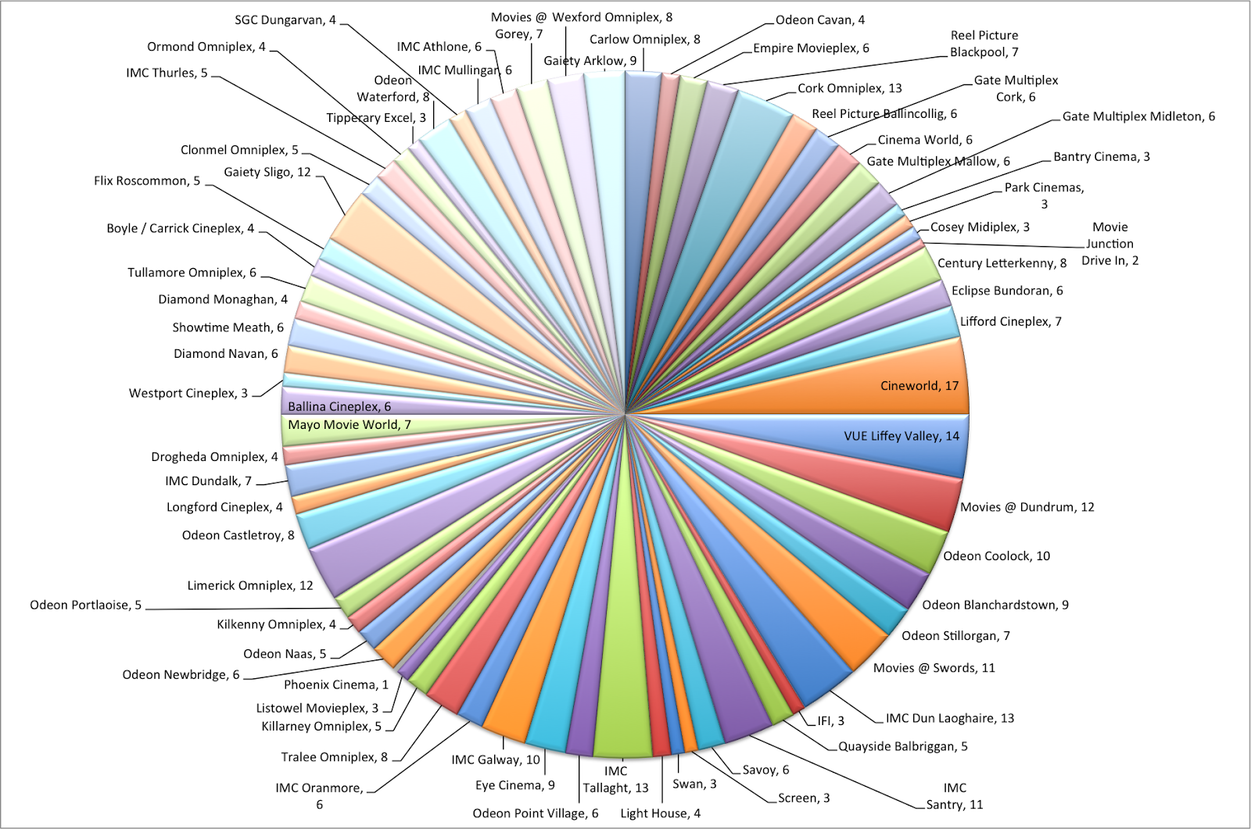

Slide 28
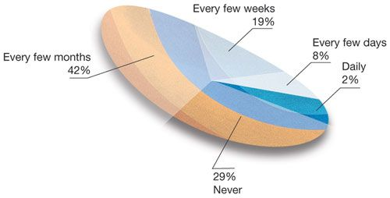

Slide 29
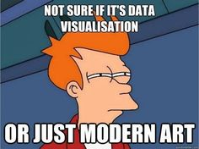

Slide 30
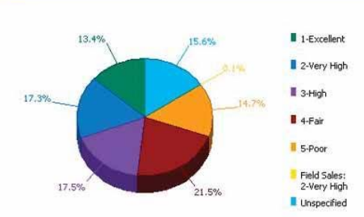


Slide 31
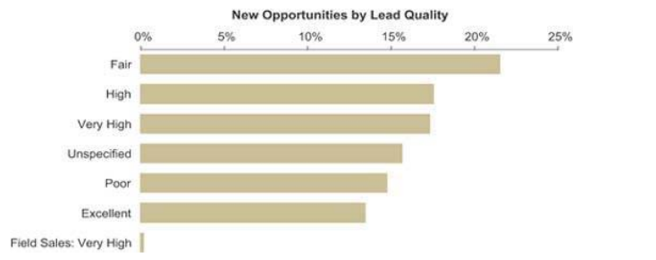


Slide 32
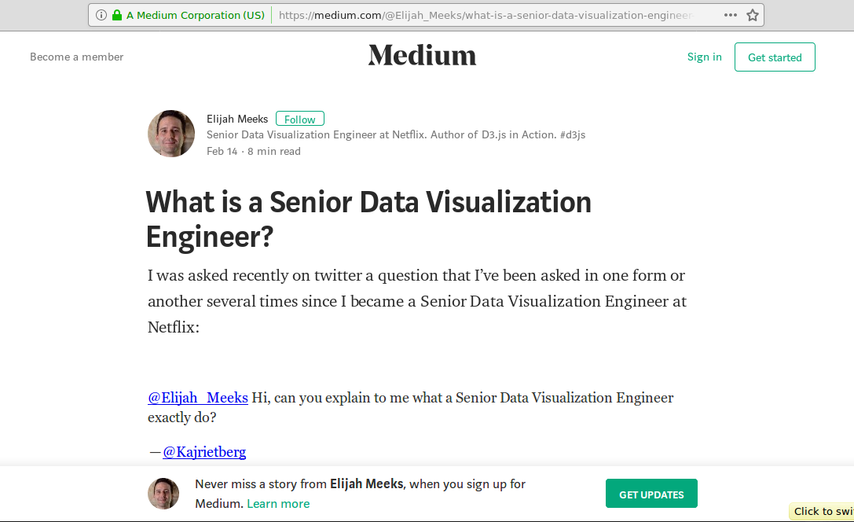

Slide 33
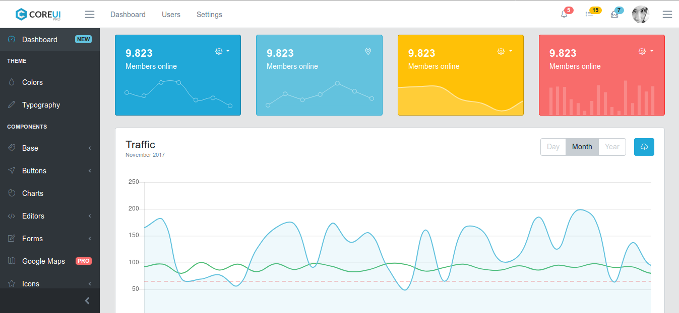

Slide 34
Tools?

Slide 35
Introduction to R & Shiny Framework

Slide 36

Introduction to R
A programming language
A free software environment for statistical computing
An interpreted language
Supports procedural, functional and object-oriented programming.

Slide 37
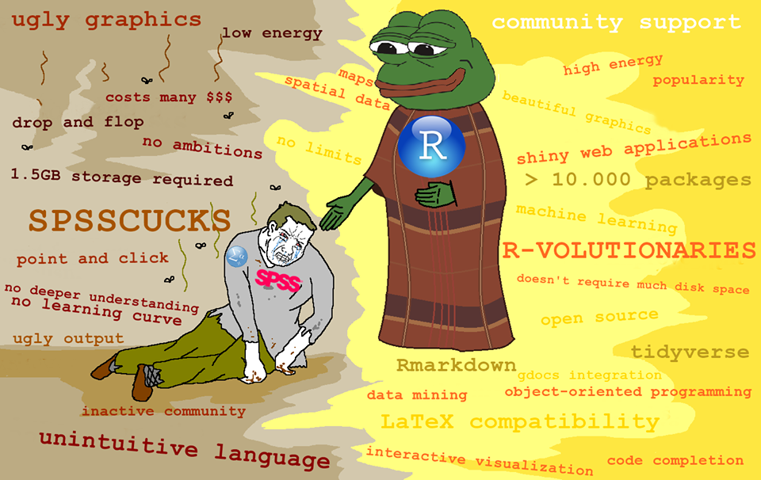

Slide 38
Basic Syntax
> print(“Hello, world!”) # Hello world in R
Hello, world!
> x <- c(1, 2, 3, 4, 5, 6) # Create ordered collection (vector)
> y <- x^2 # Square the elements of x
> print(y) # print (vector) y
[1] 1 4 9 16 25 36
> mean(y) # Calculate average (arithmetic mean) of (vector) y; result is scalar
[1] 15.16667
> var(y) # Calculate sample variance
[1] 178.9667

Slide 39
Basic Syntax
> a = seq(1,5) #Generate sequence
> a
[1] 1 2 3 4 5
> b = 11:15 #Generate Sequence
> data.frame(a,b) #Build dataframe
a b
1 1 11
2 2 12
3 3 13
4 4 14
5 5 15
> matrix(1:9, 3,3) #Generate 3 x 3 matrix
[,1] [,2] [,3]
[1,] 1 4 7
[2,] 2 5 8
[3,] 3 6 9

Slide 40
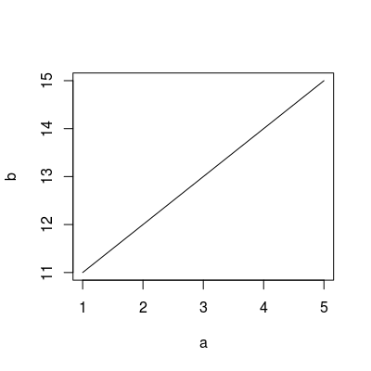
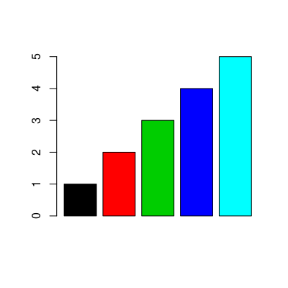
Basic Syntax
> plot(a,b)
> barplot(height = a, col=1:length(a))

Slide 41
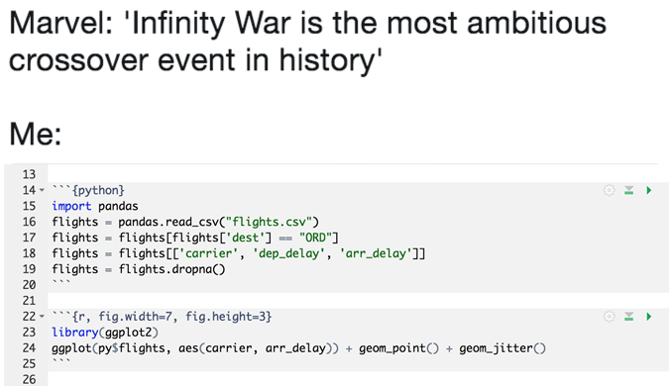

Slide 42







Slide 43





But, why R?

Slide 44
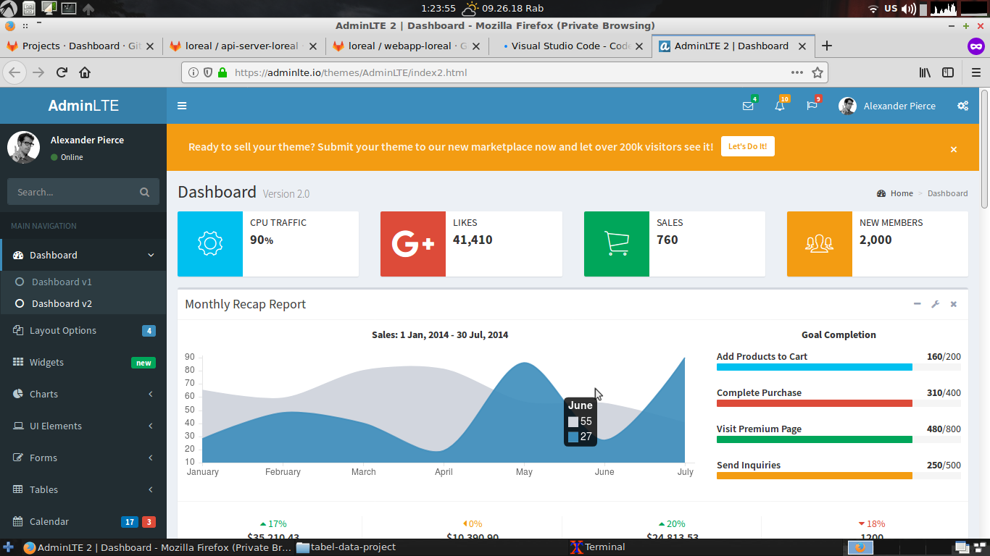

Slide 45
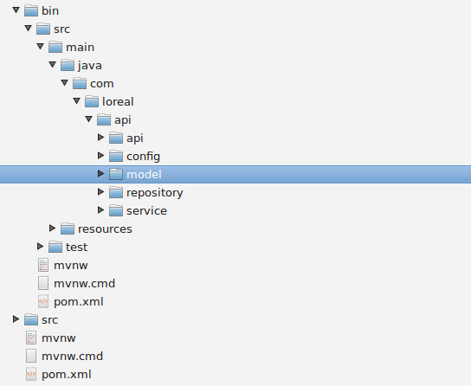
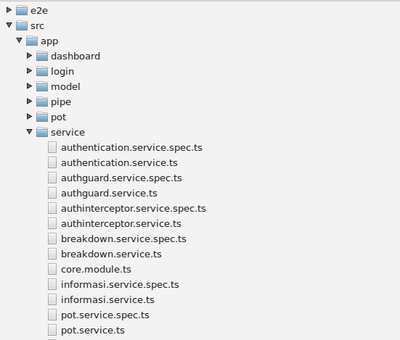
Server-Side
Client-Side

Slide 46


But, why R?

Slide 47
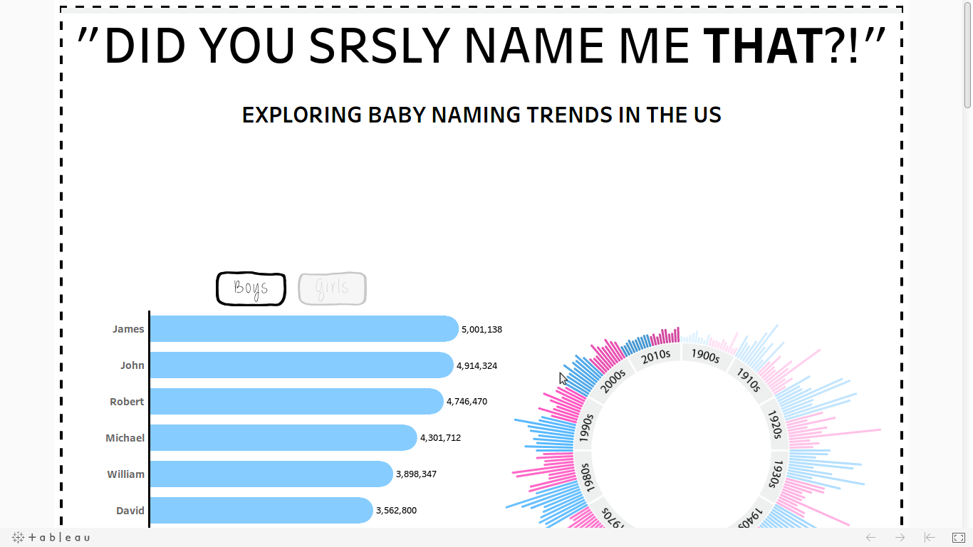

Slide 48
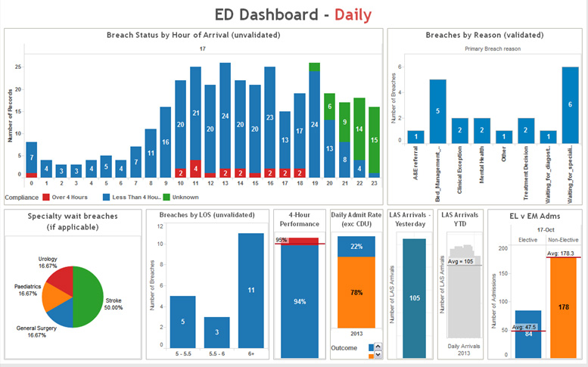

Slide 53

Shiny
R + Interactivity + web = Shiny
An R package for building interactive web applications.
Entirely extensible
Joe Cheng
CTO of RStudio, Inc. Creator of the Shiny framework.
Made by this guy...

Slide 54
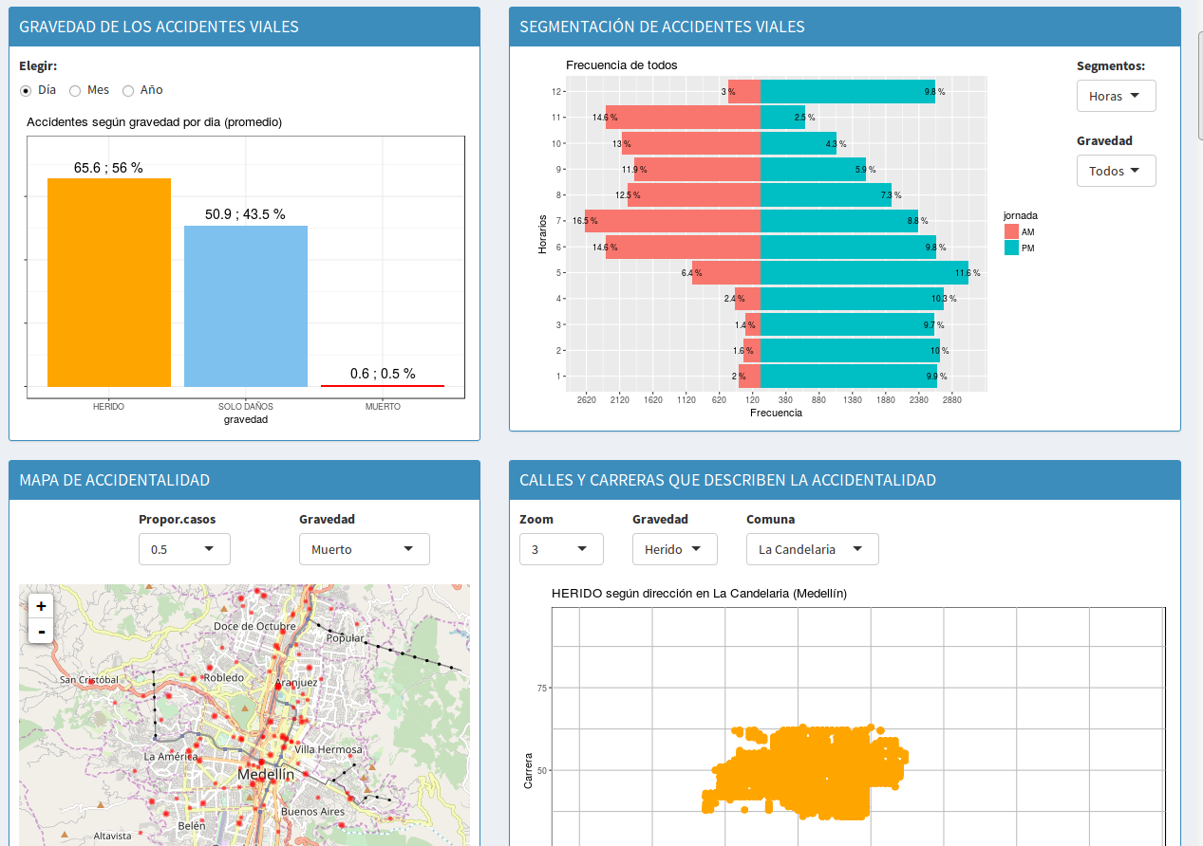
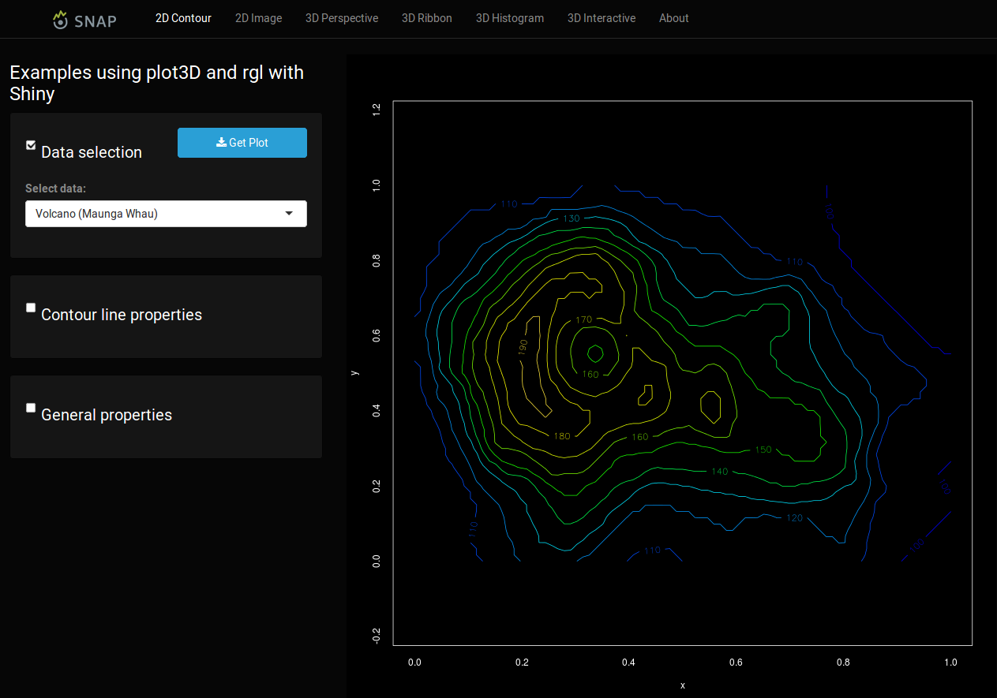
Why using shiny?
Use (only) one language to build a nice dashboard app
Reactive and responsive design
Suitable for manipulation of data
No need for HTML/CSS/Javascript for starter
Simple yet powerful enough to implement machine learning algorithm and data analytics: caret, e1071, ts, cluster, mxnet, keras, etc
Open source library and free to use

Slide 55
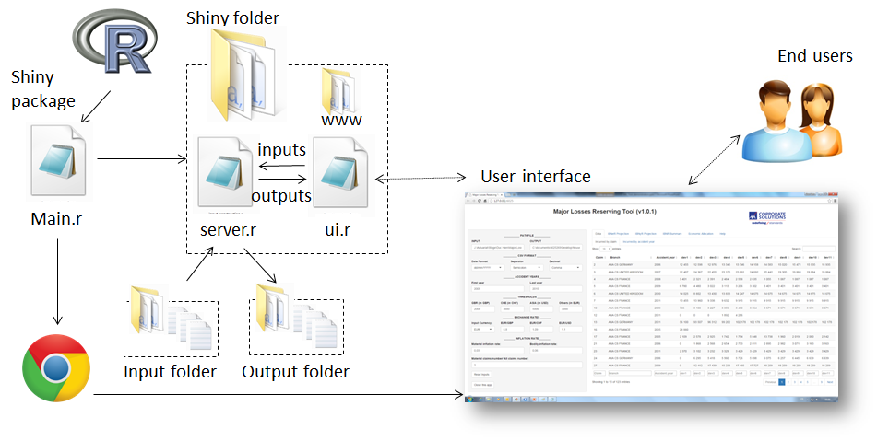
http://littleactuary.github.io/blog/Web-application-framework-with-Shiny/

Slide 56
Two Parts of Shiny App
The UI
Parts where you design its layout.
The Server
Parts where you implement business logic.

Slide 57
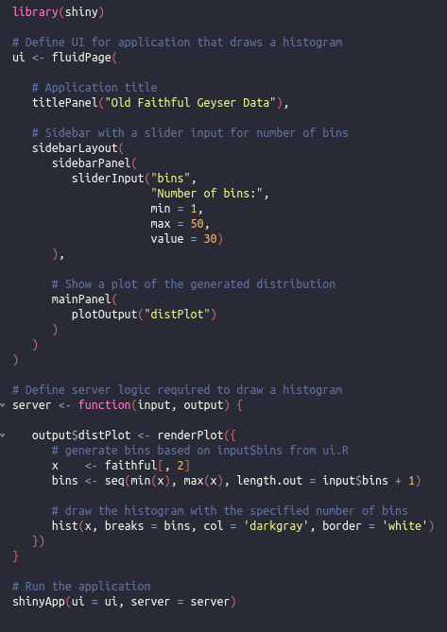
Two Ways to Code
Single File
UI
Server

Slide 58
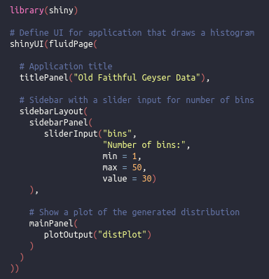
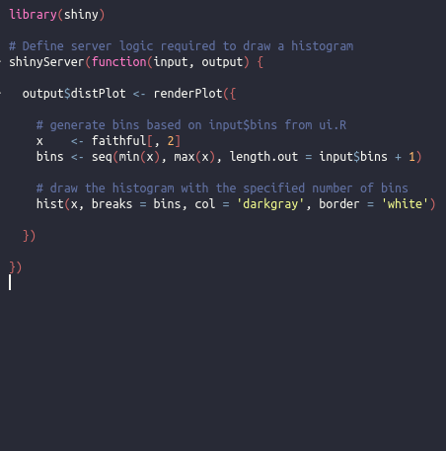
Two Ways to Code: Two Files
UI
SERVER

Slide 59
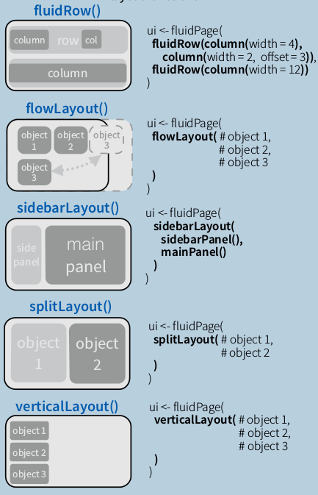
5 Basic Layouts
Don’t need to worry about HTML + CSS + Javascript boilerplate, Shiny provide it for you.

Slide 60
EXAMPLE

Slide 62
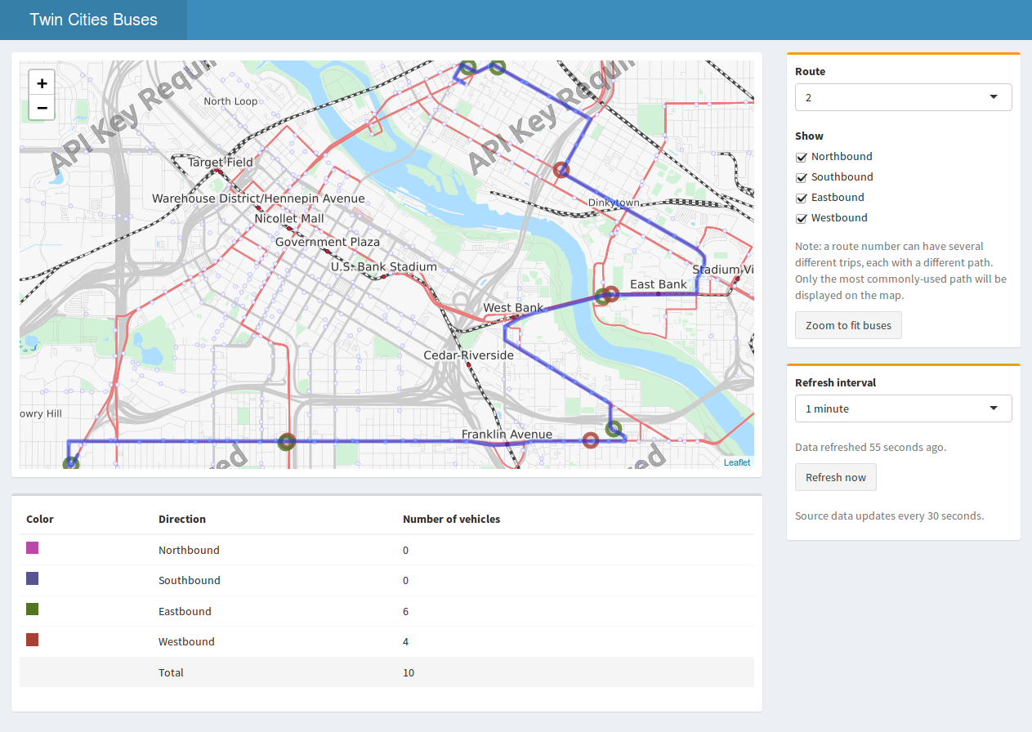
Another Modern Dashboard Template: AdminLTE

Slide 63
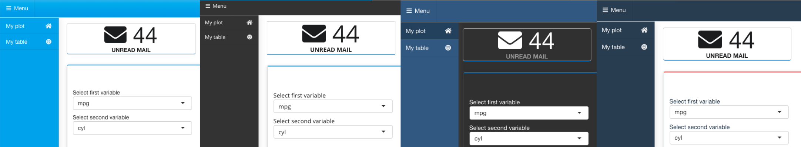
Another Modern Dashboard Template: Semantic

Slide 64
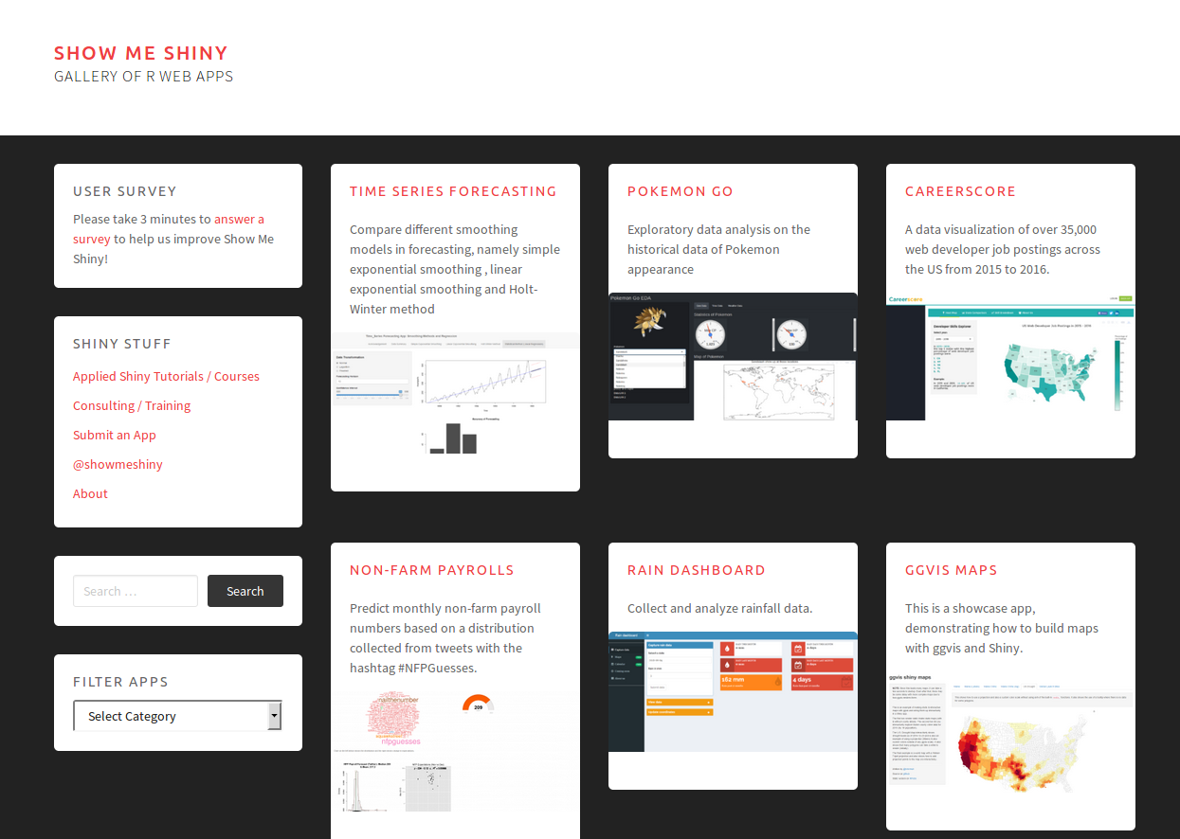
Other Example
Check:
Rstudio – Shiny:
https://shiny.rstudio.com/gallery
Show Me Shiny:
https://www.showmeshiny.com/
Shinyapps Gallery:
https://shinyapps-recent.appspot.com

Slide 65
Live Coding Session

Slide 66
Design Our UI
Title Panel
Sidebar
Main Panel

Slide 67
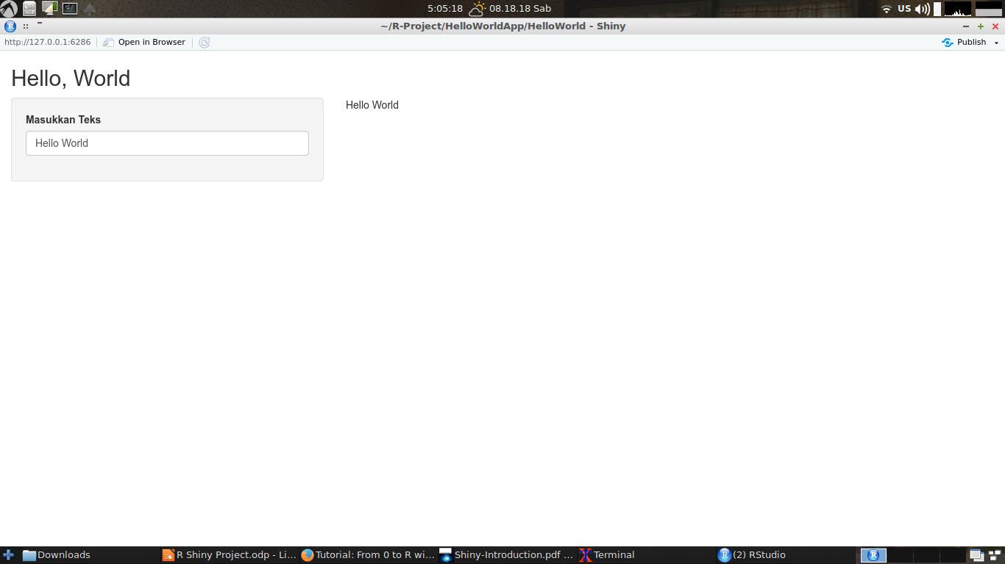

Slide 68
Shiny “Hello, World!” Example UI Side
library(shiny)
shinyUI(fluidPage(
titlePanel("Hello, World"),
sidebarLayout(
sidebarPanel(
textInput(inputId = "textInput",
label = "Masukkan Teks",
placeholder = "Tulis apa saja")
),
mainPanel(
textOutput("textHere")
)
)
))

Slide 69
Shiny “Hello, World!” Example Server Side
library(shiny)
# Define server logic required to draw a histogram
shinyServer(function(input, output) {
output$textHere <- renderText({
input$textInput
})
})

Slide 70
library(shiny)
shinyUI(fluidPage(
titlePanel("Hello, World"),
sidebarLayout(
sidebarPanel(
textInput(inputId = "textInput",
label = "Masukkan Teks",
placeholder = "Tulis apa saja")
),
mainPanel(
textOutput("textHere")
)
)
))
library(shiny)
# Define server logic required to draw a histogram
shinyServer(function(input, output) {
output$textHere <- renderText({
input$textInput
})
})
Input → Things user can play with.
Output → Things user can see, oftentimes depend on input.

Slide 71
library(shiny)
shinyUI(fluidPage(
titlePanel("Hello, World"),
sidebarLayout(
sidebarPanel(
textInput(inputId = "textInput",
label = "Masukkan Teks",
placeholder = "Tulis apa saja")
),
mainPanel(
textOutput("textHere")
)
)
))
library(shiny)
# Define server logic required to draw a histogram
shinyServer(function(input, output) {
output$textHere <- renderText({
input$textInput
})
})
Send value(s) to server
Input → Things user can play with.
Output → Things user can see, oftentimes depend on input.

Slide 72
library(shiny)
shinyUI(fluidPage(
titlePanel("Hello, World"),
sidebarLayout(
sidebarPanel(
textInput(inputId = "textInput",
label = "Masukkan Teks",
placeholder = "Tulis apa saja")
),
mainPanel(
textOutput("textHere")
)
)
))
library(shiny)
# Define server logic required to draw a histogram
shinyServer(function(input, output) {
output$textHere <- renderText({
input$textInput
})
})
Render output to UI
Input → Things user can play with.
Output → Things user can see, oftentimes depend on input.

Slide 73
Run Demo App

Slide 74
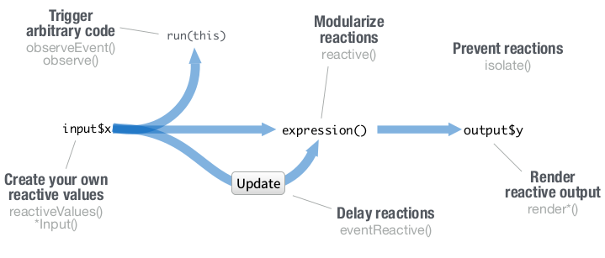

Slide 75
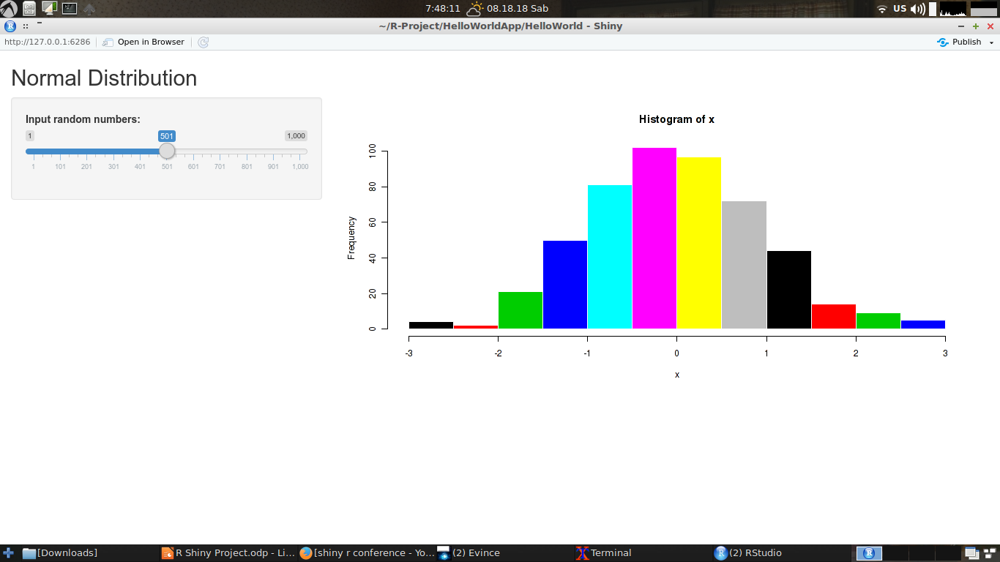
Build More Complex App

Slide 76
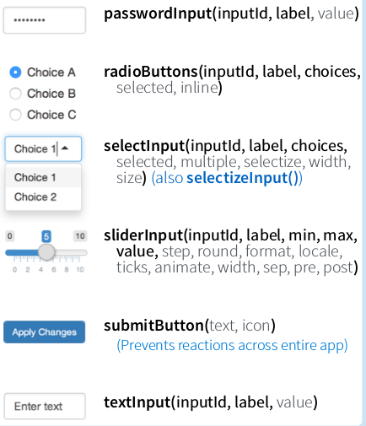


Type Of (Basic) Input

Slide 77

Type of (Basic) Output

Slide 78

library(shiny)
# Define UI
shinyUI(fluidPage(
# Application title
titlePanel("Normal Distribution"),
# Sidebar with a slider input
sidebarLayout(
sidebarPanel(
sliderInput("randomize",
"Input random numbers:",
min = 1,
max = 1000,
value = 30)
),
# Show a plot of the generated distribution
mainPanel(
plotOutput("histogramPlot")
)
)
))

Slide 79
library(shiny)
# Define server logic required to draw a histogram
shinyServer(function(input, output) {
output$histogramPlot <- renderPlot({
# Generate random numbers
x <- rnorm(input$randomize, mean = 0, sd = 1)
# Plot histogram based on input
hist(x, col = seq(1,length(x)), border = 'white')
})
})

Slide 80
Run Demo App

Slide 81
But, when not use Shiny?

Slide 82


Slide 83
Other Web Framework for R
OpenCPU: https://www.opencpu.org/
Jug: http://bart6114.github.io/jug/
Fiery: https://github.com/thomasp85/fiery
Plumber: https://www.rplumber.io/
ShinyProxy: https://www.shinyproxy.io/

Slide 84
Thanks!

